Slide 1

1 chronicles 14:1 – 17:27
A CD of this message will be available (free of charge immediately following today's message
This message will be available via podcast later this week at calvaryokc.com

Slide 2
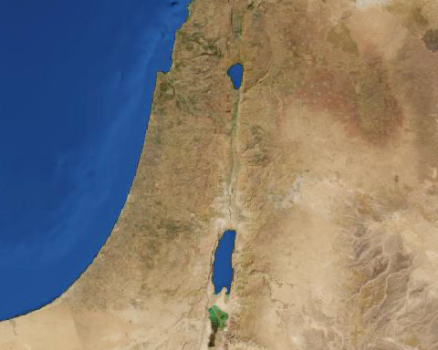
1 chronicles 14:1 – 17:27
The "journeys" of the Ark of the Covenant
Ebenezer
Shiloh
Kirjath Jearim
Gilgal
Ashdod
Ekron
Beth Shemesh

Slide 3
1 chronicles 14:1 – 17:27
Aaron
1 Sam. 2:31-35 ~ ³¹ Behold, the days are coming that I will cut off your arm and the arm of your father’s house, so that there will not be an old man in your house. ³² And you will see an enemy in My dwelling place, despite all the good which God does for Israel. And there shall not be an old man in your house forever. ³³ But any of your men whom I do not cut off from My altar shall consume your eyes and grieve your heart. And all the descendants of your house shall die in the flower of their age. ³⁴ Now this shall be a sign to you that will come upon your two sons, on Hophni and Phinehas: in one day they shall die, both of them. ³⁵ Then I will raise up for Myself a faithful priest who shall do according to what is in My heart and in My mind. I will build him a sure house, and he shall walk before My anointed forever.
8 generations
7 generations
Abiathar
Zadok
Escapes from Nob and joins David
Appointed by Saul to fill void
Joined Adonijah prior to David's death
Remained faithful to David and Solomon
Deposed by Solomon fulfilling 1 Sam. 2:31-35

Slide 4
1 chronicles 14:1 – 17:27
Consult ~ NASB, KJV – seek

Slide 5
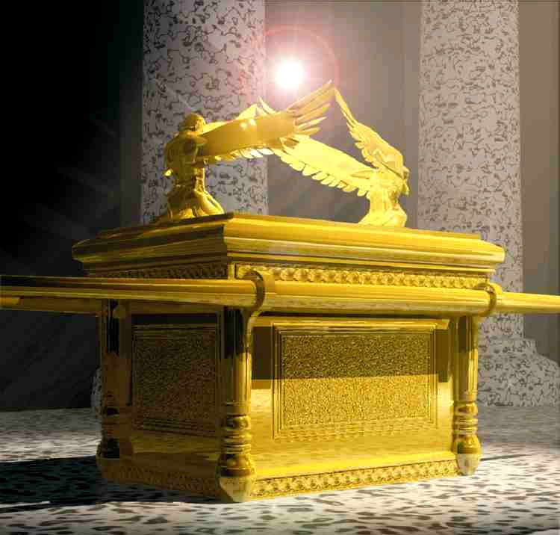
1 chronicles 14:1 – 17:27

Slide 6
1 chronicles 14:1 – 17:27
Alamoth ~ plural of Alma (virgin); probably soprano
Sheminith ~ from eighth (octave)

Slide 7
1 chronicles 14:1 – 17:27
Doorkeepers ~ i.e. ushers

Slide 8
1 chronicles 14:1 – 17:27
2 Sam. 6:23 ~ Therefore Michal the daughter of Saul had no children to the day of her death.

Slide 9
1 chronicles 14:1 – 17:27
KJV ~ And he dealt to every one of Israel, both man and woman, to every one a loaf of bread, and a good piece of flesh, and a flagon of wine.

Slide 10
1 chronicles 14:1 – 17:27
1 Chron. 16:8-22 = Ps. 105:1-15
1 Chron. 16:23-33 = Ps. 96:1-13

Slide 11
1 chronicles 14:1 – 17:27
Savonarola (1452–1498) ~ "When worship reaches the ultimate, words are not necessary."

